Slide 1



Pizza Hut Sales Analytics
View in Power BI
Last data refresh:
12/06/2024 19:44:30 UTC
Downloaded at:
12/06/2024 19:48:17 UTC

Slide 2
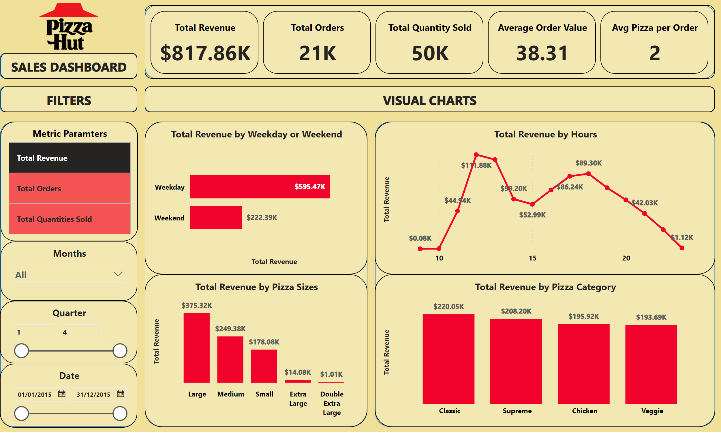
Pizza Dashboard
Notes:
image
No alt text provided
shape
No alt text provided
shape
No alt text provided
shape
No alt text provided
shape
No alt text provided
shape
No alt text provided
shape
No alt text provided
shape
No alt text provided
Metric Paramters
No alt text provided
Total Revenue by Weekday or Weekend
No alt text provided
textbox
No alt text provided
textbox
No alt text provided
textbox
No alt text provided
Months
No alt text provided
Quarter
No alt text provided
Date
No alt text provided
Total Revenue by Pizza Category
No alt text provided
Total Revenue by Pizza Sizes
No alt text provided
Total Revenue by Hours
No alt text provided
cardVisual
No alt text provided

Slide 3
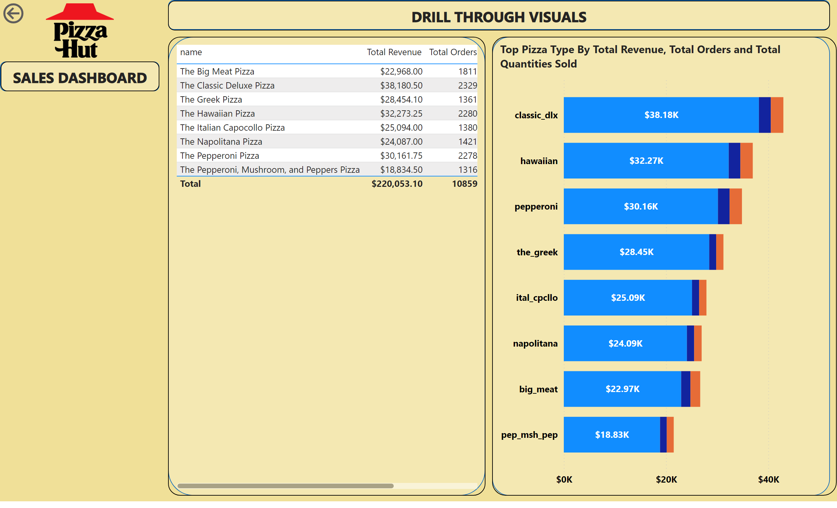
Product Performance
Notes:
image
No alt text provided
shape
No alt text provided
shape
No alt text provided
shape
No alt text provided
shape
No alt text provided
textbox
No alt text provided
textbox
No alt text provided
Top Pizza Type By Total Revenue, Total Orders and Total Quantities Sold
No alt text provided
actionButton
No alt text provided
tableEx
No alt text provided

